Slide 1

GOVERNMENT COLLEGE OF ENGINEERING BARGur (AUTONOMOUS)
PROJECT TITLE: Image recognition with IBM Cloud visual recognition.
TEAM MEMBERS:
Swetha.S
Sruthi.M.P
Kiruthika.P
Jenifer Suganthi.S
Latha Mangeskar.M.S

Slide 2
PROBLEM STATEMENT:
Design and develop an image recognition system capable of accurately identifying and categorizing objects and scenes within images, with a focus on real-world applications such as autonomous vehicles, healthcare diagnostics, or retail inventory management.

Slide 3
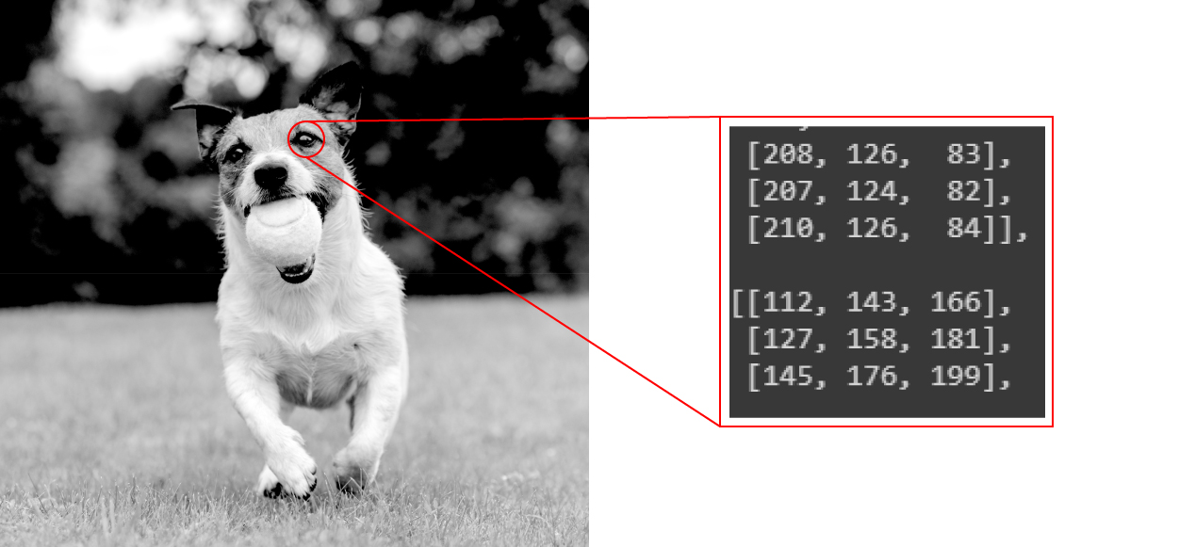
Image recognition:
Image recognition refers to technologies that identify places, logos, people, objects, buildings, and several other variables in digital images. It may be very easy for humans like you and me to recognise different images, such as images of animals.
We can easily recognise the image of a cat and differentiate it from an image of a horse. But it may not be so simple for a computer.

Slide 4
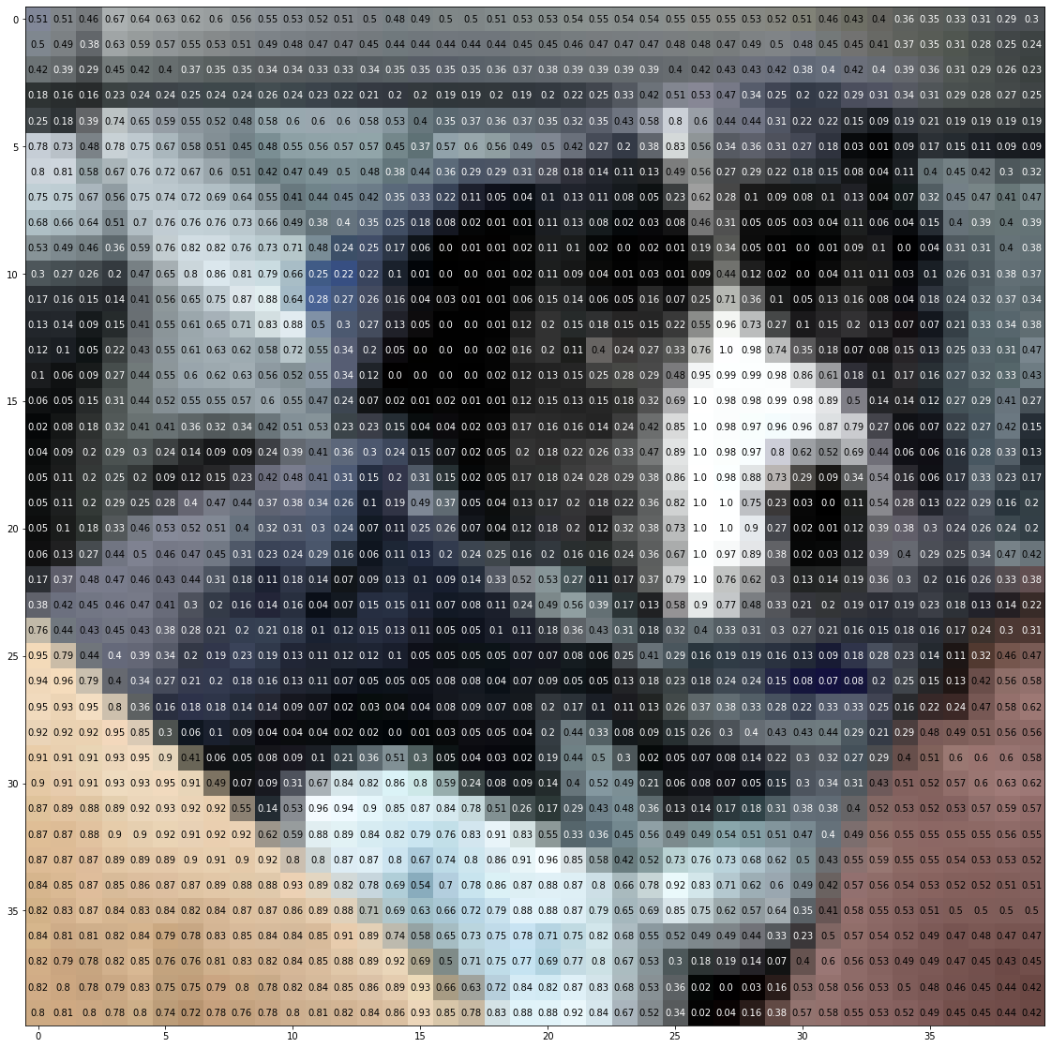
Image recognition:
An image of a dog represented by 40 x 40 pixels.

Slide 5
Working of Image Recognition:
We need a dataset containing images with their respective labels. For example, an image of a dog must be labelled as a dog or something that we can understand.
Next, these images are to be fed into a Neural Network and then trained on them. Usually, for the tasks concerned with images, we use convolutional neural network. These networks consist of convolutional layers and pooling layers in addition to Multilayer perceptron(MLP).
We feed in the image that is not in the training set and get predictions.

Slide 6
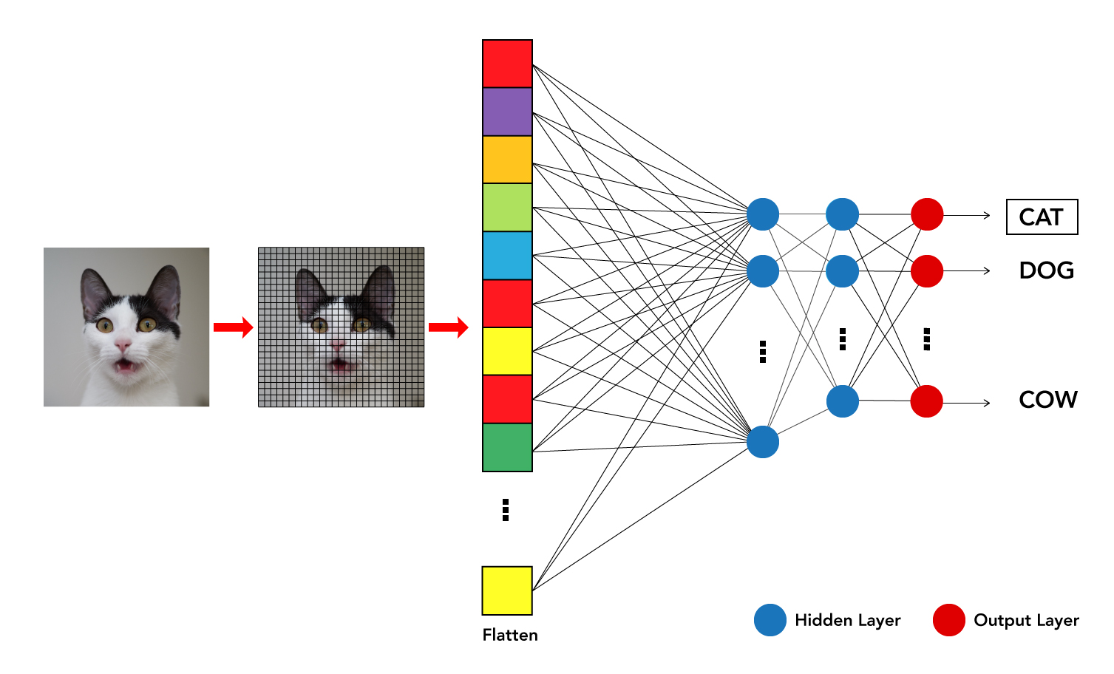
Working of Image Recognition:
For example, a model trained to recognise dogs and cat cannot recognise boats.

Slide 7
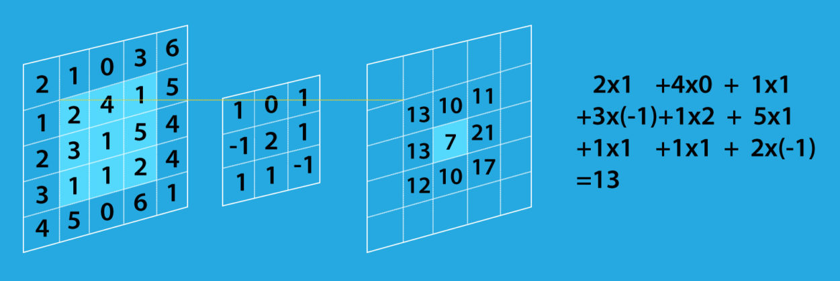
Working of Convolutional Layers:
The convolutional layer’s parameters consist of a set of learnable filters (or kernels), which have a small receptive field. These filters scan through image pixels and gather information in the batch of pictures/photos. Convolutional layers convolve the input and pass its result to the next layer.

Slide 8
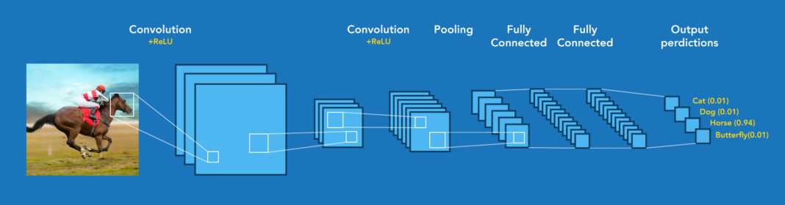
Image recognition structure:
The overall structure and sample output predictions of the image recognitions.

